Slide 1
MAJOR PROJECT - II
A Project Report
On
PORTIFY-Scan It Out

Slide 2
Submitted By –
Kritika Sharma (R134216072)
Manik Garg (R134216076)
Manila Chawla (R134216077)
Vikalp (R134216150)
Under the guidance of
Dr. Susheela Dahiya

Slide 3
Abstract
The idea is to create a tool for finding vulnerable ports on a target IP. The tool will list down the status of all the ports on the target IP address based on the range entered by the user. Furthermore, the tool will compare the open ports with the list of vulnerable ports and list down the issues and mitigation methods.

Slide 4
Introduction
Security is one of the most important aspect in current world scenario. Data being the most important and cloistered part of our lives, needs to be protected and for that purpose we need to implement various security controls at all places which are involved in any sort of data related operations. Security controls refer to the mechanisms used to restrict the access to the data or assets to maintain confidentiality, integrity and availability thus maintaining the CIA Triad.
In computer networking, a port is a communication endpoint. At the software level, within an operating system, a port is a logical concept that detects a definite process or a category of network service. Ports are identified for each protocol and address combination by 16-bit unsigned numbers, commonly known as the port number. An open port is an attack surface. The daemon that is listing on a port, could be vulnerable to a buffer overflow, or another remotely exploitable vulnerability.

Slide 5
Introduction – contd.
Different Ports have different services associated with them. Each of the service has its own sets of vulnerabilities, thus its own sets of risks. Each service maybe associated to one or more ports but vice versa is not true. For some services there are different ports available depending on the type of security like for http/https & FTP and SFTP.

Slide 6
TCP & UDP Common Ports
Protocol | TCP/UDP | Port Number
File Transfer Protocol (FTP) | TCP | 20/21
Secure Shell (SSH) | TCP | 22
Telnet | TCP | 23
Simple Mail Transfer Protocol (SMTP) | TCP | 25
Domain Name System (DNS) | TCP/UDP | 53
Dynamic Host Configuration Protocol (DHCP) | UDP | 67/68
Trivial File Transfer Protocol (TFTP) | UDP | 69
Hypertext Transfer Protocol (HTTP) | TCP | 80
Post Office Protocol (POP) version 3 | TCP | 110

Slide 7
TCP & UDP Common Ports – contd.
Protocol | TCP/UDP | Port Number
Network Time Protocol (NTP) | UDP | 123
NetBIOS | TCP/UDP | 137/138/139
Internet Message Access Protocol (IMAP) | TCP | 143
Simple Network Management Protocol (SNMP) | TCP/UDP | 161/162
Border Gateway Protocol (BGP) | TCP | 179
Lightweight Directory Access Protocol (LDAP) | TCP/UDP | 389
Hypertext Transfer Protocol over SSL/TLS (HTTPS) | TCP | 443
Lightweight Directory Access Protocol over TLS/SSL (LDAPS) | TCP/UDP | 636
FTP over TLS/SSL | TCP | 989/990

Slide 8
Problem Statement
We need to create a port scanning tool that will scan open ports and map different vulnerabilities associated with it.

Slide 9
Objectives
To create a vulnerability mapping tool that identifies vulnerable ports on a URL or target IP provided by the user and presents the results based on the port scanner along with the mitigation methods associated with each vulnerability. Following are the major modules aimed for the project:
DNS Resolution
Port Scanning
Vulnerability Mapping
Mitigation Methods

Slide 10
Methodology
Since, we are using the Incremental SDLC Model thus our methodology will be including all the phases of that model.
System Feasibility: We will be analyzing the feasibility of our product that whether it will be implementable or not. This phase has already been completed during the title analysis.
Software Plans & Requirements: During this phase we analyzed all the requirements and planned the development cycle.
Product Design: We will be developing zero Level DFD in this phase to know what modules are needed for this product.
Detailed Design: Here we will work on Level 1 DFD to show sub modules and implementable functions. We will be also working on developing the required Use Case diagram.

Slide 11
Code: This will be our main phase which will be our implementation phase where we will code all the modules. Here we will also do the unit testing.
Integration: This phase will aim at making the product out of the modules i.e. we will be merging the modules.
Implementation: This will be our system testing phase. We will test all the merged modules. This will act as level one testing for our product.
Operations & Maintenance: This is our last phase where will work towards achieving feedback and further improvements will be done accordingly.

Slide 12
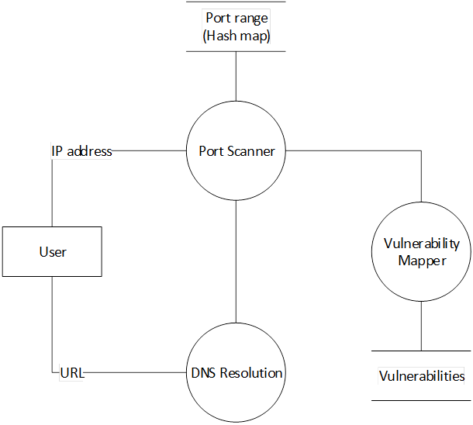
Level-0 DFD

Slide 13
Use Case Diagram

Slide 14
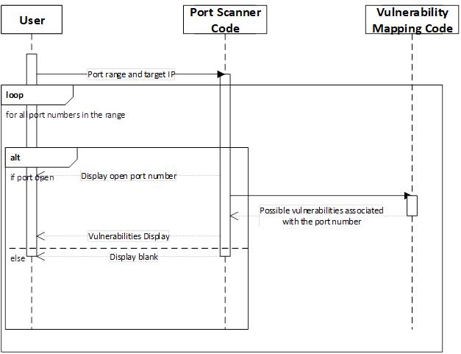
Sequence Diagram

Slide 15
Implementation
The port range and URL or target IP are given as input on the main interface. Once the user fills the details, the scanning begins along with a progress loader. Afterwards the complete status list is provided to the user along with the vulnerability status and mitigation techniques. The port scanner is created by making a socket connection to the target IP for each port and store the status as open and closed based on the connection success in a HashMap.
Steps: -
Create a module for main menu interface.
Create independent modules for port scanning and vulnerability listing.
Create a module for mapping open ports to associated vulnerabilities
Club the Modules using Bottom Up approach.

Slide 16
Pseudo Code
Import following java packages:
import java.util.*;
For Socket class: import java.net.*;
For HashMap class: import java.util.HashMap;
User can enter the following details:
Target URL or IP address
Port Range
Implement HashMap for storing the port number and its status:
HashMap<Integer, String> port = new HashMap<>
Create a socket connection:
Socket soc = new Socket(ip,i);
Store the status in the HaspMap:
In case the port is open: port.put(i,"Open");
In case the port is closed: port.put(i,"Closed");
Display the vulnerabilities associated with open ports
Display the mitigation techniques of the associated vulnerabilities.

Slide 17
Schedule
Starts on Jan 20
Start of Feb
Mid of Feb
Requirement analysis
Start of March
Mid of March
Implementation phase continued
Start of April
Feasibility study
Designing phase and initial Implementation Phase
Integration phase
Mid of April
Testing phase
Mid of April
Project ends

Slide 18
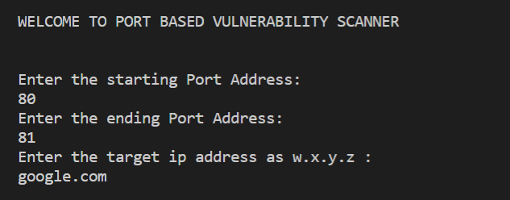
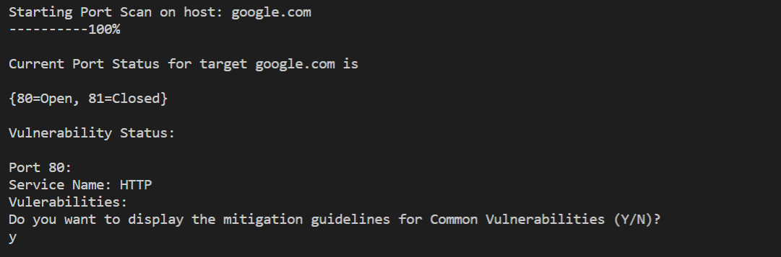
Output

Slide 19
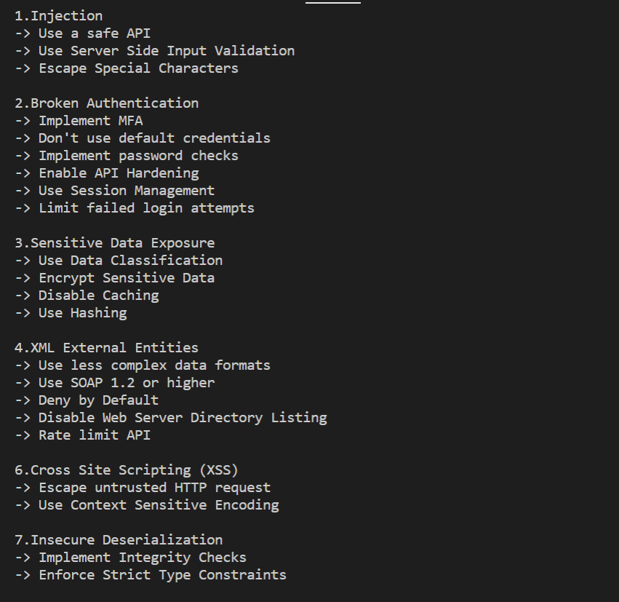
Output - Contd.

Slide 20
Result Analysis
As a part of our project, we were successfully able to achieve our objective of making a vulnerability mapping tool which that identifies vulnerable ports on a URL or target IP provided by the user and presents the results based on the port scanner along with the risk associated with each vulnerability. In this project, we have performed the following –
DNS resolution,
Port Scanning on a URL/IP address,
Identification of vulnerabilities associated to open ports, and
Mitigation techniques

Slide 21
References
Aggarwal, K. and Singh, Y., 2008. Software Engineering. New Delhi: New Age International.
Owasp.org. 2020. OWASP Top Ten. [online] Available at: <https://owasp.org/www-project-top-ten/> [Accessed 10 Feb 2020].
Pentest-Tools.com. 2020. Online Port Scanner with Nmap - Discover Open TCP Ports | Pentest-Tools.Com. [online] Available at: <https://pentest-tools.com/network-vulnerability-scanning/tcp-port-scanner-online-nmap> [Accessed 12 Feb 2020].
Wilkins, S., 2020. TCP/IP Ports and Protocols | TCP/IP Ports and Protocols | Pearson IT Certification. [online] Pearsonitcertification.com. Available at: <https://www.pearsonitcertification.com/articles/article.aspx?p=1868080> [Accessed 17 April 2020].

Slide 22

THANK YOU

